Slide 2
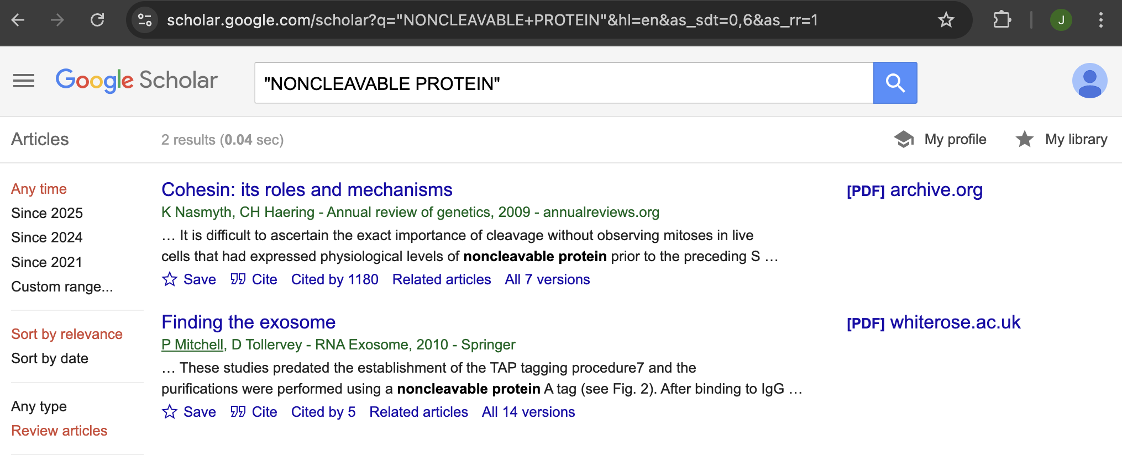

Slide 3
https://link.springer.com/article/10.1007/s00281-024-01023-8
“The critical windows for the immune development are the stem cell, hepatic hematopoiesis, myeloid, immunocompetence and memory periods. YS; yolk sac, EMP; erythro-myeloid progenitors, AGM; aorta-gonad-mesonephros, HSCs; hematopoietic stem cells, PND; postnatal day. Figure modified from Soares-da-Silva [46] and Veru [44]”

Slide 4
https://link.springer.com/article/10.1007/s00281-024-01023-8
stem cell
hepatic hematopoiesis
Myeloid
immunocompetence and memory periods

Slide 5
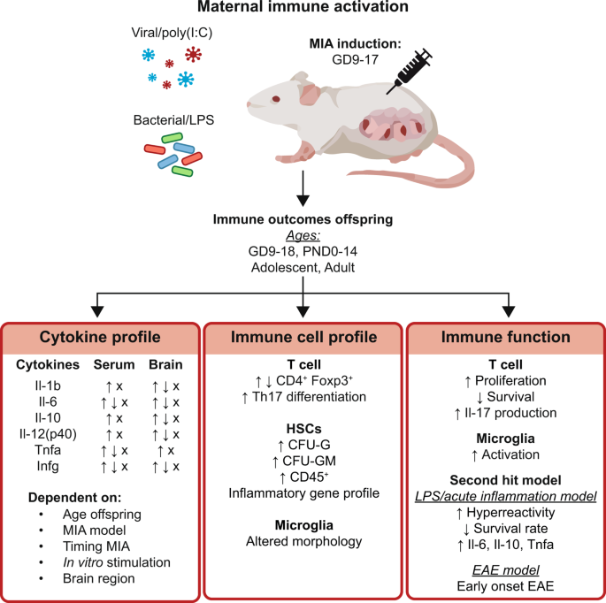
https://link.springer.com/article/10.1007/s00281-024-01023-8
stem cell
hepatic hematopoiesis
Myeloid
immunocompetence and memory periods

Slide 6
The fetal programming effect of maternal immune activation (MIA) on the offspring’s immune system https://link.springer.com/article/10.1007/s00281-024-01023-8
“Effect of MIA on offsprings immune cell profile
Alterations in the peripheral immune cell profile have been observed for offspring exposed to MIA and are summarized in Table 2. A few studies demonstrated differences in cell composition in the MIA offspring. Contradicting results were reported for CD4⁺Foxp3⁺ splenocytes in adult offspring exposed to MIA, with both elevated and reduced levels being reported [73, 77]. Also, an increase in CD4⁺Foxp3⁺CD25⁺ regulatory T (Treg) cells was reported in splenocytes [69]. The splenocytes from offspring exposed to MIA from dams immunized before pregnancy showed preferential differentiation into Th17 cells [74, 86, 87]. Furthermore, an elevation in peripheral Gr-1⁺ cells was described, suggesting a skewing in the hematopoietic stem cells (HSC) or progenitor cells toward neutrophils and monocytes [77]. A colony-forming assay demonstrated increased differentiation into granulocyte precursors (CFU-G), and decreased differentiation into early granulocyte-macrophage precursors (CFU-GM). Similar results were observed for the colony-forming assay of fetal liver HSCs and progenitors of MIA offspring, showing an altered myeloid lineage potential and differentiation of the MIA offspring [77]. Alterations in the immune profile were found in the small and large intestinal lamina propria, with an increase in Th17 cells showing that MIA can affect tissue-specific immunity [88]”

Slide 7
The fetal programming effect of maternal immune activation (MIA) on the offspring’s immune system https://link.springer.com/article/10.1007/s00281-024-01023-8
“Effect of MIA on offsprings immune cell profile
Alterations in the peripheral immune cell profile have been observed for offspring exposed to MIA and are summarized in Table 2. A few studies demonstrated differences in cell composition in the MIA offspring. Contradicting results were reported for CD4⁺Foxp3⁺ splenocytes in adult offspring exposed to MIA, with both elevated and reduced levels being reported [73, 77]. Also, an increase in CD4⁺Foxp3⁺CD25⁺ regulatory T (Treg) cells was reported in splenocytes [69]. The splenocytes from offspring exposed to MIA from dams immunized before pregnancy showed preferential differentiation into Th17 cells [74, 86, 87]. Furthermore, an elevation in peripheral Gr-1⁺ cells was described, suggesting a skewing in the hematopoietic stem cells (HSC) or progenitor cells toward neutrophils and monocytes [77]. A colony-forming assay demonstrated increased differentiation into granulocyte precursors (CFU-G), and decreased differentiation into early granulocyte-macrophage precursors (CFU-GM). Similar results were observed for the colony-forming assay of fetal liver HSCs and progenitors of MIA offspring, showing an altered myeloid lineage potential and differentiation of the MIA offspring [77]. Alterations in the immune profile were found in the small and large intestinal lamina propria, with an increase in Th17 cells showing that MIA can affect tissue-specific immunity [88]”

Slide 8
Ekelund L, Laurell CB (1994). “The pregnancy zone protein response during gestation: a metabolic challenge”. Scandinavian Journal of Clinical and Laboratory Investigation. 54: 623-629.

